Slide 1
CSAP Chapter 1
A Student Collaborative Presentation
Period 2

Slide 2
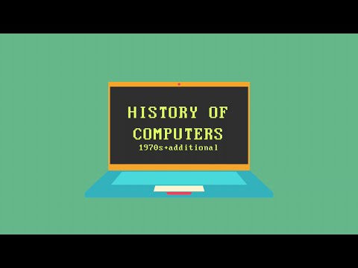
1.1 History of Computers
1940s - ENIAC was one of the world’s first digital electronic computers
1950s - IBM sold its first business computer. At the time, it was estimated that the world would never need more than 10 such machines
The first computers had a mere 1/2000 of the typical 2-gigahertz laptop computer that can be found today.
1960s - time-sharing computers became popular at organizations large enough to afford them
1970s - e-mail and file transfers were born
1980s - personal computers appeared
1990s - computers appeared on many desktops and in many homes
2000s - computing has become ubiquitous

Slide 3
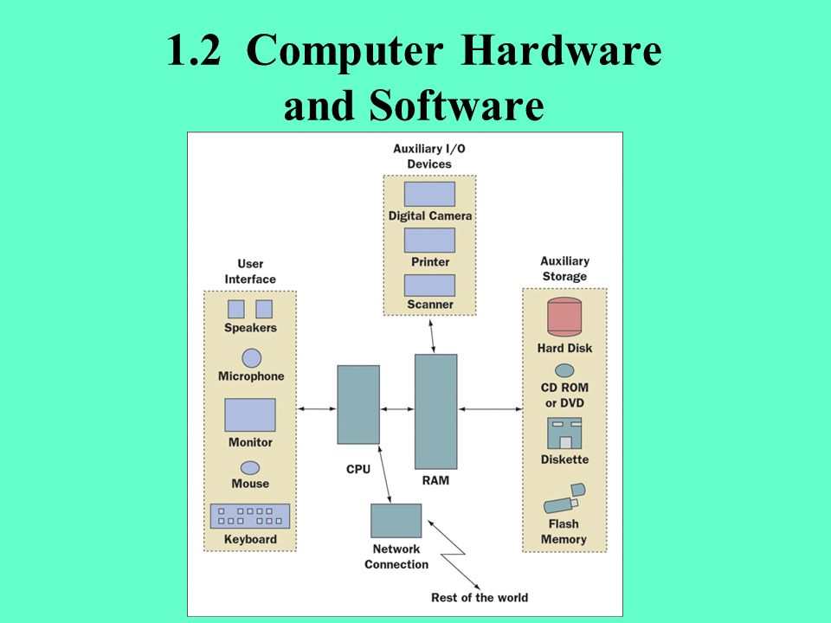
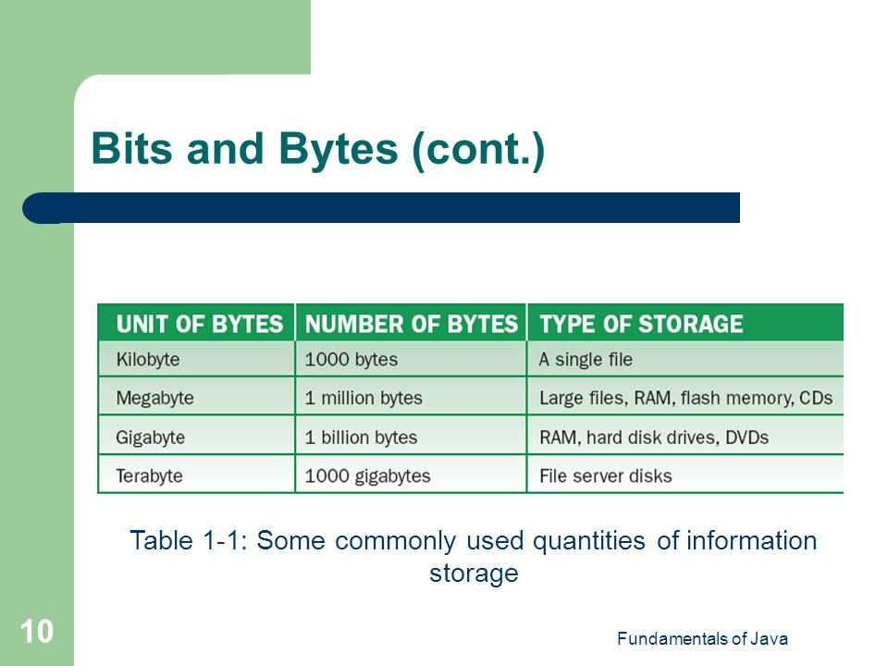
1.2 Computer Hardware
Hardware- physical devices that you see on your desktop
Bit (binary digit)- smallest unit of information
A byte is made up of 8 bits
6 Major Subsystems
User Interface- Supports moment-to-moment communication between a user and the computer, using input, such as from mouses and keyboards, and output, such as from monitors and screens
Auxiliary Input/Output(I/O)- Devices that can be used for the computer to communicate with humans, being able to both receive input and output information
Auxiliary Storage Devices- Secondary storage that stores, in hard drives, the computer’s operating system, applications, and documents
Network Connection- A modem (modulator-demodulator) or other devices which connect to the internet
RAM- High speed internal memory, also referred to as primary memory. Momentary storage of data and programs.
CPU (central processing unit)

Slide 4
1.2 Central Processing Unit
The central processing unit (CPU) does the work of the computer
CPU performs simple arithmetic; the programs that direct the CPU’s operations may be complex
A programmer determines how to translate a complex task into a series of simple operations
CPU hardware is very complex: millions of transistors are packed onto a tiny silicon chip
Moore’s Law: the speed of computers doubles every 2 years as the number of transistors increases
The transistor, the basic building block of the CPU & RAM, has two states- ON, conducting electricity, or OFF, not conducting electricity
All information in a computer is expressed in terms of ONs & OFFs, or 1s & 0s
RAM: Essentially, a large arrays of 1s & 0s
CPU: Merely a device for transforming patterns of 1s & 0s into other patterns of 1s & 0s
Sequence of events: CPU loads program from auxiliary storage to RAM, copies the program from RAM, decodes it, and executes it in the ALU
After execution of the program, the data portion of RAM has the results of the computation

Slide 5
1.2 Computer Software
System Software: supports the basic operations of a computer and allows human users to transfer information to & from the computer
Operating system
File system for transferring information to & rom disk & schedulers for running multiple programs concurrently
Communications software
Connecting to other computers & the internet
Compliers
Translating user programs into executable form
User interface subsystem
Manages the look & feel of the computer
Application Software: allows human users to accomplish specialized tasks
Word processors
Spreadsheets
Database systems
Multimedia software
Other programs we write

Slide 6
Exercises 1.2
1)What is the difference between the bit and the byte?: A bit or binary digit is the smallest unit of information processed by a computer and consists of a single 0 or 1. A byte consists of eight adjacent bits.
2) Name two input devices and two output devices: The keyboard & mouse and microphone are input devices. The monitor/screen and speakers are output devices.
3)What is the purpose of auxiliary storage devices? They are for long term storage of data and programs.
4) What is RAM and how is it used? RAM stands for random access memory, or primary memory. The components are lost when the computer turns off, but when the computer is running, RAM is loaded from auxiliary storage with needed programs and data.
5)Discuss the differences between hardware and software: Hardware consists of the physical devices that you see on your desktop, and software consists of the programs that give the hardware useful functionality.

Slide 7
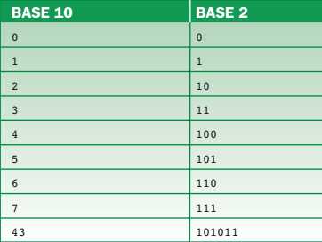
1.3 Binary Representation of Integers and
Floating-Point Numbers
How integers and floating-point numbers are expressed in binary notation
Integers:
Bases are used to clarify what number system is used:
2 → Binary
2^N can be used to clarify the amount of storage, where N is the number of bits
8→ Octal
10 → Decimal
16 → Hexadecimal
Human Counting: Power of 10 - Humans count this way due to the 10 fingers.
Example: 19 = (1 * 10^1) + (9 * 10^0)
Computer Counting: Power of 2 - Computers count this way due to the on/off nature of electrical current.
Example: 10011 = (1 * 2^4) + (0 * 2^3) + (0 * 2^2) + (1 * 2^1) + (1 * 2^0) = 19

Slide 8
1.3 Binary Representation of Integers and
Floating-Point Numbers
Floating-Point Numbers:
numbers with a fractional part
expressed with mantissa/exponential notation (number is rewritten as value between 0 and 1 times a power of 10) * for base 10
354.98₁₀ = 0.35498₁₀ * 10³
expressed similarly with base 2
10001.001₂ = 0.10001001₂ * 2⁵
101₂ = 5₁₀ (meaning two different bit sequences )
mantissa’s leading 1 suppressed because IEEE standard computers add digit before decimal
initially a 7-bit code; extended to 8-bit code
Base 10 | Base 2
2 | 10
3 | 11
5 | 101

Slide 9
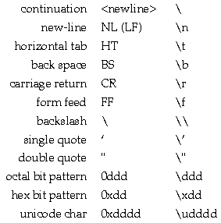
1.3 Binary Representation of
Characters and Strings
Characters:
A to Z (lowercase and uppercase)
0 to 9
+, *, -, /, etc.
Command characters
In the ASCII scheme, each character equals 8 bits or 1 byte. They range from 0000 0000 to 1111 1111.
Strings:
Sequences of Characters
Each character is coded in ASCII or Unicode and “strung” together
Java uses Unicode, which represents each character by a pattern of 16 bits.

Slide 10
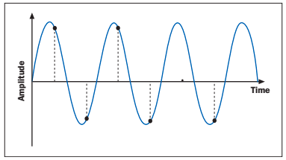
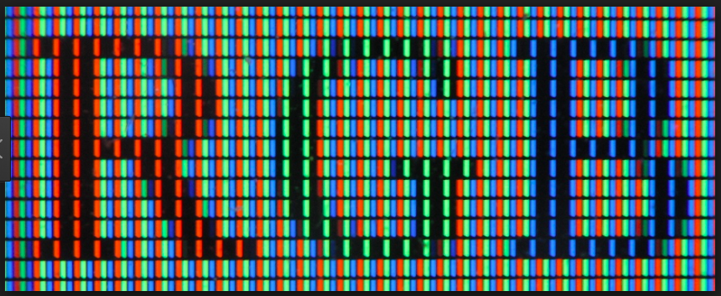
1.3 Sound, Images, Video, Program
Instructions, Computer Memory
Sound:
The information is stored in sound is analog, which has an infinite range.
The sound wave could be graphed as a periodic wave function with the amplitudes as volume, and wavelength as sound frequency, aka pitch.
Since this information is infinite, the computer would use a sampling technique to determine the pitch and volume of the information, and recreate that sound.
Images:
Images in nature a analog and have infinite length and with in 2 dimensions. Objects like cameras and video recorders translate the analog image into a small points called pixels.
Each pixel for a black and white image, each pixel has either 3 bits for 8 shades of gray or 8 bits for 256 shades of gray. However, for a color image, each pixel has a 8 bit number for three colors: red, green, and blue. Each color pixel could have a 16,777,216 different hues.
Video:
Video includes 2 elements to play. First, it needs a soundtrack and frames. Frames are individual pictures that are played at 16 to 24 frames per second to simulate realistic motion.

Slide 11
1.3 Sound, Images, Video, Program
Instructions, Computer Memory
Program Instructions: Program instructions are represented as a sequence of bits in RAM.
0000 1001 / 0100 0000 / 0100 0010 / 0100 0100
The first 8 bits has the add operation code
The second 8 bits has the location of the first operand
The third 8 bits has the location of the second operand
The fourth 8 bits has the location of where to put the sum
Computer Memory:
A computer’s memory can be seen as a gigantic sequence of bytes.
A byte’s location in memory is called its address.
Addresses are numbered from 0 to 1 less than the number of bytes of memory installed on that computer
A group of contiguous bytes can represent a number, a string, a picture, a chunk of sound, or a program instruction.

Slide 12
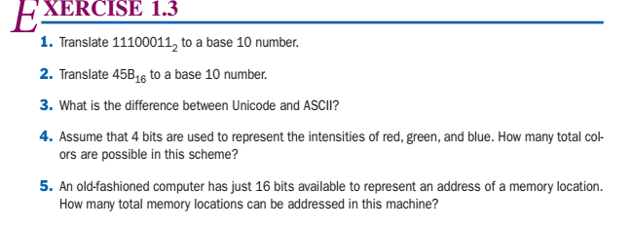
Exercise 1.3
227
1115
ASCII has 128 characters, so it can fit in 8 bytes. Unicode is an expanded version of ASCII. “Unicode is ASCII on steroids” - Ms. Quan.
(2⁴)³ = 4096
2¹⁶ = 65536

Slide 13
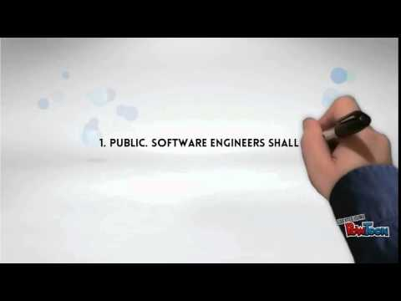
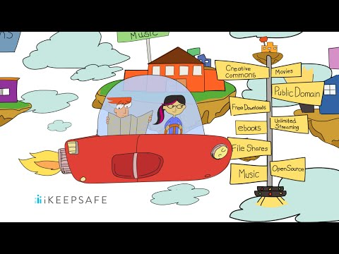
Computer Ethics according to
ACM (pg 18 and 27)
Computer Ethics
Copyrights Rules

Slide 14
Exercise 1.4
1.) It is difficult for one programmer to read another’s program. Entering a single number incorrectly can ruin the whole program.
2.)Not portable and more friendly than machine lang
3.) A loader is used to load and run programs written in assembly.
4.)The difference between assembly and high level languages is that a high-level language is more human friendly compared to an assembly language.

Slide 15
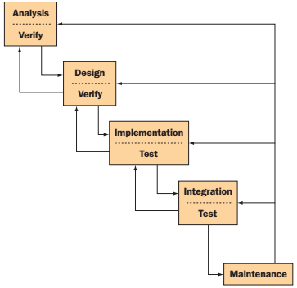
1.5 The Software Development Process
Software development life cycle (SDLC)
Customer request - The programmers receive a broad statement of a problem that is potentially amenable to a computerized solution. This step is also called the user requirements phase.
Analysis - The programmers determine what the program will do. This is sometimes viewed as a process of clarifying the specifications for the problem.
Design - The programmers determine how the program will do its task.
Implementation - The programmers write the program. This step is also called the coding phase.
Integration - In the integration phase, these parts are brought together into a smoothly functioning whole.
Maintenance - Programs usually have a lifespan of 5 to 15 years. This time, known as the maintenance phase, requirements change and modifications must be made.

Slide 16
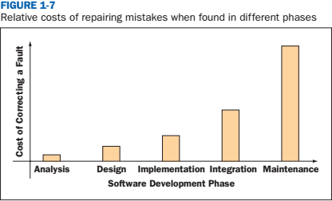
Exercise 1.5
What happens during the Analysis and Design phases of the waterfall model of software development?
The programmers determine what the program will do and how it will do it.
Which phase of the waterfall model of software development incurs the highest cost to developers?
Maintenance
Why would a programmer back up to an earlier phase in the waterfall model of software development?
If there was a problem with the original program, or the customer needs to add more, they might have to go back a few steps.
In which phase of the waterfall model of software development is the detection and correction of errors the least expensive?
Analysis

Slide 17
1.6 Basic Concepts of OOP
The computer software is created in a process called programming, the program is composed of different classes which describes instance variables and methods. As the program does only what it is told, any problems or deficiencies are highly problematic. Therefore programmers need to be exceedingly thorough.
Object-orient programming is a method of programming that was developed due to the inadequacies of the procedural approach, the previous method of programming found in older languages
Writing object-oriented programming involves a “divide and conquer” method, breaking thousands of lines of code into simple “communicating” components the user can understand
Comparison of OOP procedure to “expedition in search of the lost treasure of Balbor”
Planning: determine the types of members needed (classes), how many of each type, and define their responsibilities. A list of resources (state) and the rules of behavior (behavior) are required
Execution: Recruit the team members and assemble them. Send the team in and wait for the outcome (calling methods, objects run simultaneously, run the program)
Outcome: Good or bad (success or failure. If failure, revise the team and repeat)

Slide 18
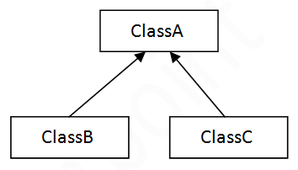
Exercise 1.6
In what way is programming like planning the construction of a house?
Before creating a program, you must think about the structure to make sure that it does not fail. Creating the outline of the program is the same as drawing out a blueprint.
An object-oriented program is a set of objects that interact by sending messages to each other. Explain
When object A sends a message to object B, the object B checks its class to find a corresponding rule to execute. If Object A needs service which it cannot provide for itself using its own class, then it requests the service form Object B and its class.
What is a class, and how does it relate to objects in an object-oriented program?
A class is a set of instructions to build a specific type of object. It is related to objects because every object is built from a class.
Explain the concept of inheritance with an example.
In JAVA, classes can be derived from other classes which means that they inherit aspects of other classes.
Explain the concept of information hiding with an example.
If Object A needs service which it cannot provide for itself using its own class, then it requests the service from Object B and its class. However, Object A knows nothing about Object B and its data sources. This is called information hiding or abstraction.

